Slide 1
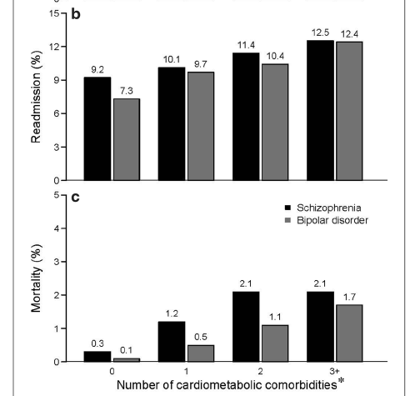
Costs of cardiovascular comorbidities
Schizophrenia
In a retrospective database analysis, patients with schizophrenia were stratified based on the number of ICD-9-CM cardiometabolic comorbidities they had, and their healthcare-use data was analysed¹
Of more than 50,000 patients with schizophrenia:¹
  66% had at least one cardiometabolic comorbidity
  39% had two or more cardiometabolic comorbidities
Greater cardiometabolic burden was associated with increased likelihood of readmission to hospital, and higher costs¹
Thirty-day all-cause readmission, and hospital mortality,
by number of cardiometabolic comorbidities¹
Number of cardiometabolic comorbidities
Number of cardiometabolic comorbidities
ICD-9-CM=International Classification of Diseases 9th revision – Clinical Modification
1. Correll et al. Ann Gen Psychiatry 2017;16:9
Notes:
This was a retrospective analysis of hospital data from the Premier Perspective Database® between April 2010 and June 2012.^{[Correll et al., 2017]} The study aimed to determine the prevalence of cardiometabolic comorbidities among hospital inpatients with schizophrenia and bipolar disorder and to assess the role of incremental cardiometabolic comorbidity burden on length of stay, mortality, and healthcare costs during the initial admission.^{[Correll et al., 2017]} The cardiometabolic comorbidities that were screened for included: cerebrovascular disease, coronary or ischaemic heart disease, diabetes mellitus, hyperglycaemia, hyperlipidaemia, and hypertension.^{[Correll et al., 2017]} After the 118,065 potential patients with schizophrenia were screened according to exclusion criteria, a total of 57,506 patients were included in the analysis.^{[Correll et al., 2017]}
The outcomes analysed were the length of stay in hospital, the readmission rate, and the mortality rate, stratified based on whether the patient had 0, 1, 2, or 3 or more cardiac comorbidities.^{[Correll et al., 2017]} As shown on the graph, the hospital readmission rate increased as the number of cardiac comorbidities increased, as did the mortality rate (the latter seeming to peak at 2 or more comorbidities).^{[Correll et al., 2017]} In terms of total costs, each incremental cardiometabolic comorbidity was associated with an 8.3% increase in costs (not shown on slide).^{[Correll et al., 2017]} These results demonstrate the added burden that cardiovascular/cardiometabolic comorbidites place on patients with schizophrenia, and reinforce the need for improved detection and management of cardiovascular health in this population.^{[Correll et al., 2017]}
Reference:
Correll CU, Ng-Mak DS, Stafkey-Mailey D, et al. Cardiometabolic comorbidities, readmission, and costs in schizophrenia and bipolar disorder: a real-world analysis. Ann Gen Psychiatry 2017; 16: 9.

